Slide 1

IS 610-Case B (Group 4) Aggregate Planning at Green Mills - Fall 2023
I S 610 Sec01 12349 Business Data Analysis
(Dr. Ming Chen)
Team Members :
Vishakha Maruti Sonmore
Anusha Manchi Satish
Deepak Balasaheb Deokar
Saumya Chandrakant Prasad
Bommalapura Panjaru Shashidhar Reddy

Slide 2

AGENDA
01
Case Study – Aggregate planning at Green Mills
02
Chase Strategy
03
Level Strategy
04
Optimal Strategy
05
Conclusion

Slide 3

Case Study – Aggregate planning at Green Mills
Aim : The objective is to create an aggregate plan with the lowest possible total cost.
Summary :
Green Mills Inc. attempted to implement a backward vertical integration approach.
Various aggregate planning strategies are employed to formulate the annual cost plan.
By examining each conclusion, we determine the most effective strategy for achieving the minimum total cost.

Slide 4

Backward vertical integration strategy
Involves a company going backwards in the value chain and making a business entry into a supplier.
To avoid giving suppliers too much control over the company, Green Mills Inc. attempted to implement a backward vertical integration strategy.

Slide 5
Aggregate Planning
The process of creating, evaluating, and keeping up with a rough, preliminary schedule of an organization's general operations.
Includes customer backlogs, production and inventory levels, as well as targeted sales forecasts.

Slide 6

Why do organizations need Aggregate Planning?
Quicker execution of well-curated plans.
Achieving budgetary goals by increasing output and decreasing overall variable costs.
Prioritizes meeting demands and ensuring client satisfaction.
Making optimal use of the production capacity that is available.
By matching demand and cutting down on customer wait times, you can satisfy customers.
Spend less on inventory stocking.
It can help synchronized flow throughout the supply chain it affects costs, equipment utilization, employment levels and customer satisfaction.

Slide 7




Advantages of Aggregate Planning
Minimize Staffing Fluctuations
Increase Production Rates
Accommodate Changes

Slide 8
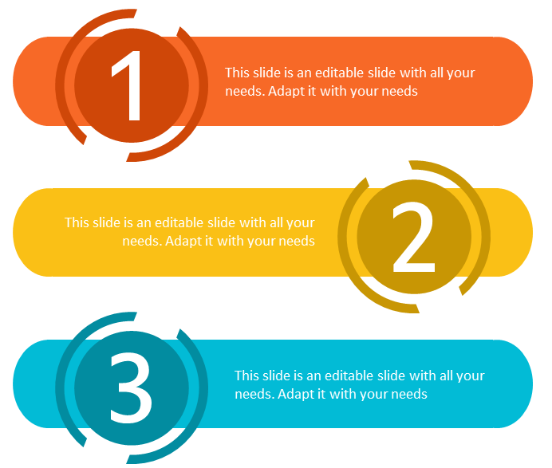
Aggregate Planning Strategy
CHASE STRATERGY
LEVEL STRATERGY
OPTIMAL STRATERGY
Notes:
Links:
https://www.pexels.com/photo/photo-of-person-holding-black-tablet-3734641/

Slide 9
Chase Strategy
As the name implies, this strategy involves chasing demand.
The business only makes products when there is a market for them.
A chase strategy calls for hiring or firing staff in order to match capacity and demand period by period.

Slide 10
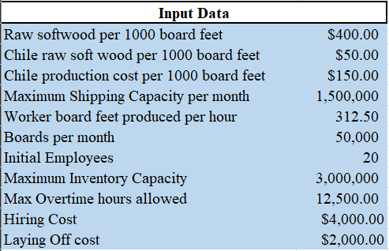
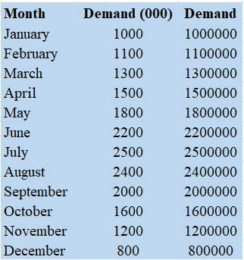

Input data

Slide 11
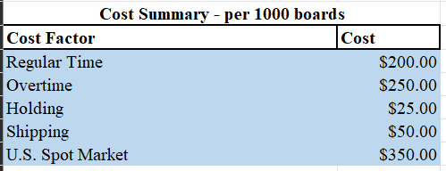
Input data

Slide 12
Chase Strategy
Implementation
When a company uses a chase strategy, it needs to be able to quickly adjust its capacity in order to be able to quickly change its output level.
Ex: If you order food at a restaurant, the employees will "chase the demand.“
Spot market and overtime are not taken into account in this case strategy.
Spot market: Cash payments for commodities are made instantly as well as the trading of financial instruments for instant delivery.

Slide 13



Chase Strategy
Advantages &
Disadvantage
ADVANTAGE
DISADVANTAGE
Lower inventory levels
Flexibility to meet demands
Saves time
Hiring cost
Laying off cost
Longer lead times from order to delivery

Slide 14
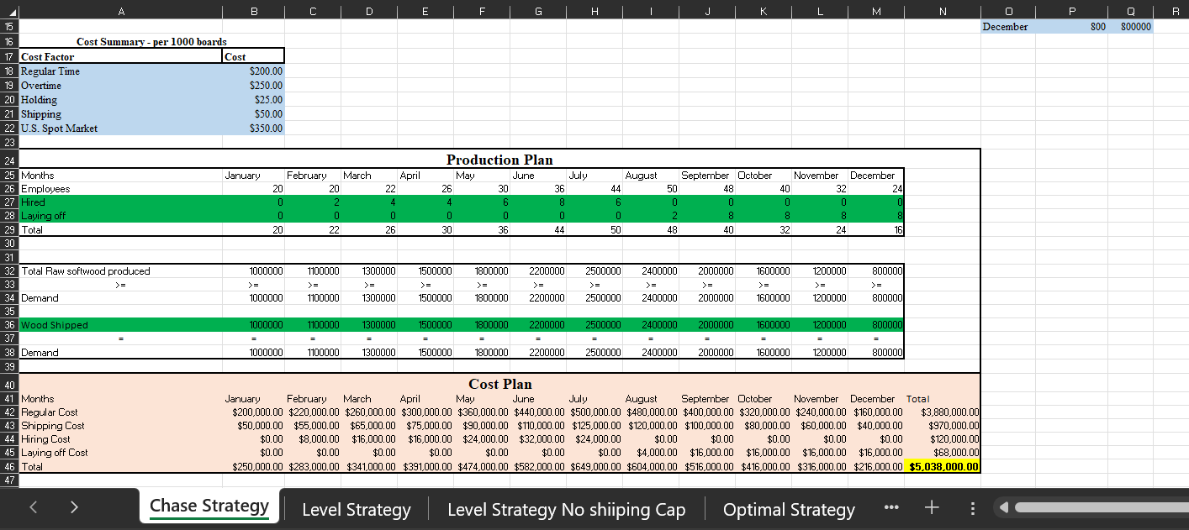
Cost Plan for Green Mill Inc Using Chase strategy

Slide 15


Level Strategy Benefits
Enables a firm to maintain a constant production level and still meet demand.
This approach is more convenient to the employee since working conditions remain constant .
There is no hiring and firing costs.

Slide 16
Level Strategy
Maintaining the workforce and production rate is the aim of an aggregate planning strategy.
To decide whether to raise or lower production levels in response to changing customer demands, precise demand forecasting is necessary.
With no hiring or firing expenses, it boasts a steady workforce.

Slide 17
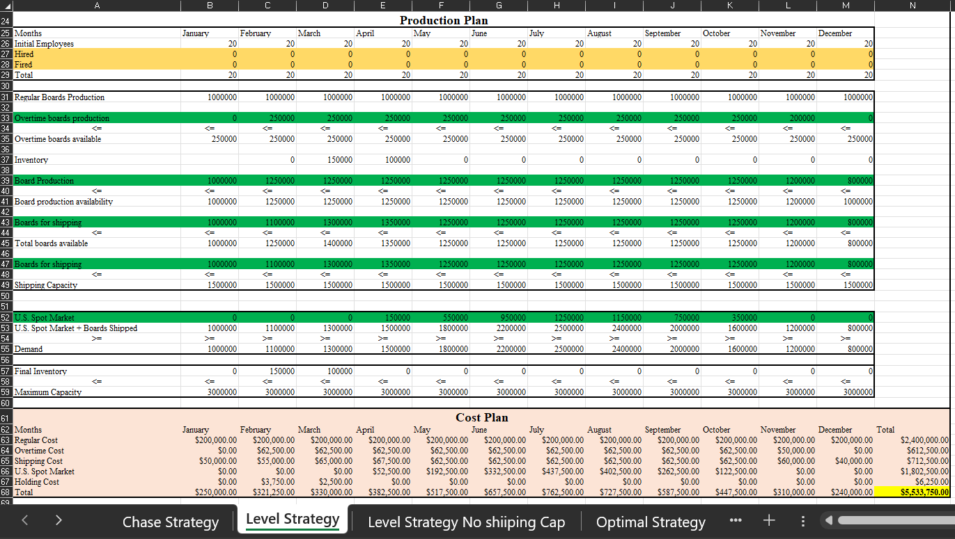
Cost Plan for Green Mill Inc Using Level Strategy

Slide 18
Optimal Strategy
Optimal strategy combines elements of both level and chase strategies in its aggregate planning approach.
The chase strategy hires and fires workers based on market conditions whereas the level strategy increases work hours to meet demand.
In industries with seasonality, when launching new products, and when market conditions change, we can employ Optimal strategy.

Slide 19
Optimal Strategy Benefits
It can help to reduce cost
Avoid excess storages
Maintaining a predictable production schedule.

Slide 20
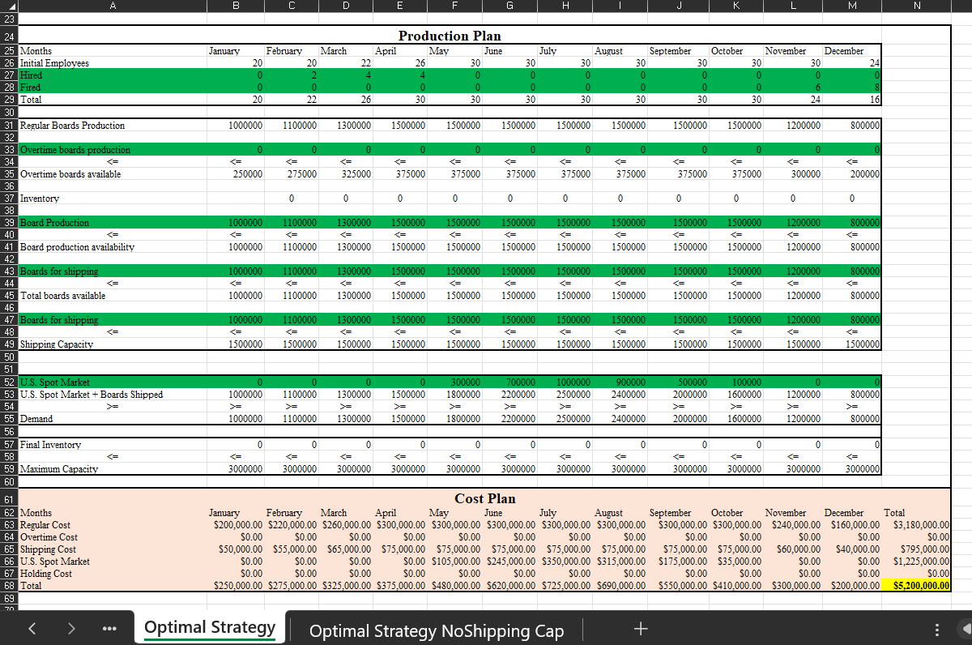
Cost plan for green mills INC using Optimal strategy

Slide 21
Conclusion
The total cost incurred for the whole year in level planning is $4,963,750.00
The total cost incurred for the whole year in chase planning is $4,756,000.00
The total cost incurred for the whole year in optimal planning is $4,601,250.00
From this analysis, we conclude that optimal strategy is the ideal solution which has the minimal cost that Green Mills can implement for successful aggregate planning.

Slide 22

THANK YOU!
Q&A..

